Slide 1
Team:
Alzards
Area of Interest:
Anomaly Detection(AI/ML)
Team Members:
Karan Dhiman: 2010993681
Isheeta Chopra: 2010993652
Anshum Srivastava: 2010991485
Anshum: 2010993515

Slide 2
Our Team CV(S)

Slide 3

Karan Dhiman
A curious person, ever ready for learning and opportunities
Contact Number: +91-7015678374
Email: karan3681.be20@chitkara.edu.in

Slide 4

Isheeta Chopra
An adaptable data oriented fresher with great business acumen
Contact Number: +91-9411077900
Email: isheeta3652.be20@chitkara.edu.in

Slide 5
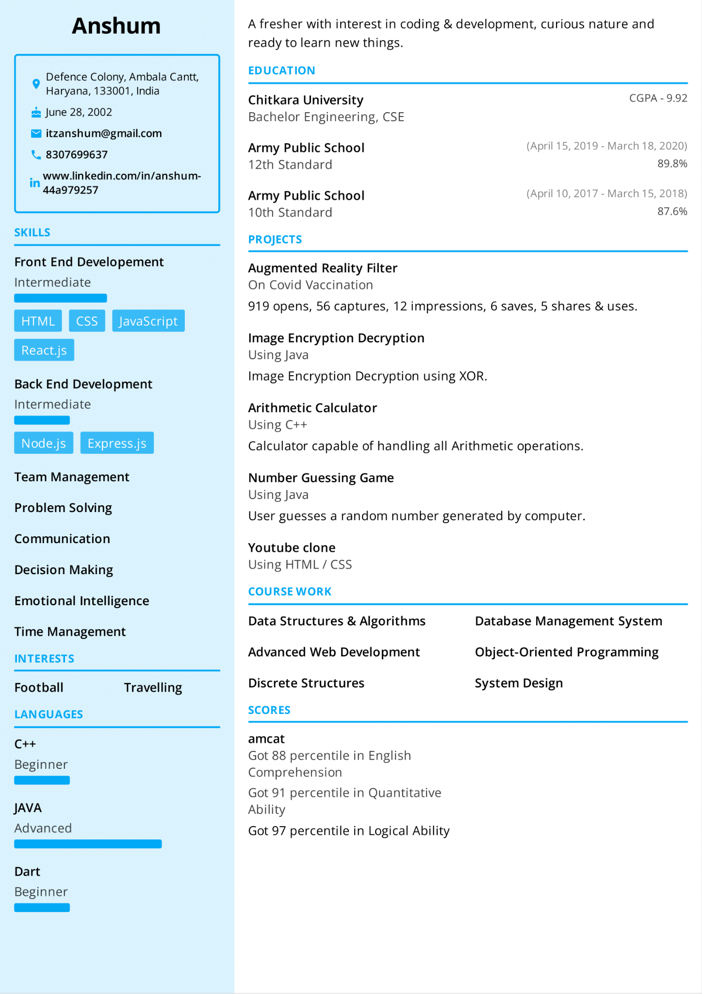
Anshum
A curious fresher with ready to learn attitude and love of coding
Contact Number: +91-8307699637
Email: anshum3515.be20@chitkara.edu.in

Slide 6

Anshum Srivastava
A problem solver with interest in human nature
Contact Number: +91-6239537481
Email: anshuman1485.be20@chitkara.edu.in

Slide 7
Problem Statement
Objective: Build a machine learning model to identify potentially anomalous transactions or user activities based on a given dataset.
Key Tasks:
Identify multiple patterns in the dataset.
Predict potentially anomalous data and determine the reason for the anomaly.
Identify the attribute(s) responsible for the anomaly.
Predict all possible unique patterns across all attributes.
Develop an API for real-time anomaly prediction for individual records and sets of records for a day.

Slide 8
Data Set Overview
Features:
1. Login Timestamp: Provides temporal information that can be useful for detecting time-based anomalies or patterns.
2. User ID: Helps track individual user activities and identify anomalies specific to certain users.
3. IP Address: Can be used to detect suspicious or unusual login locations or IP addresses associated with known malicious activities.
4. Country, Region, City: Allows analysis of regional patterns, identification of activities from specific countries or areas, and detection of login events outside the expected regions.
5. Browser Name and Version: Helps in identifying browser-specific anomalies, such as outdated or suspicious browser versions.
6. Device Type: Enables detection of anomalies related to specific device types or unusual login activities from a particular device category.
7. Login Successful: Differentiates between successful and failed login attempts, which can be useful for identifying login-related anomalies or attacks.
Unsupervised Learning Problem:
In an unsupervised learning problem, we aim to discover patterns or anomalies in the data without relying on predefined labels.
Our objective is to train a machine learning model that can learn from the dataset's inherent structure and identify anomalies or unusual patterns without prior knowledge of specific instances.

Slide 9
Motivation
Anomaly detection plays a critical role in various industries, such as finance, cybersecurity, fraud detection, and predictive maintenance.
Detecting anomalies can help identify potential risks, suspicious activities, or system failures before they cause significant damage or loss.
Traditional rule-based approaches for anomaly detection often lack the ability to capture complex patterns and require manual tuning.
Machine learning-based approaches can leverage the power of algorithms and statistical modeling to automatically learn patterns and detect anomalies more accurately and efficiently.
Building a robust anomaly detection system will enable us to gain actionable insights from data, enhance security measures, and improve operational efficiency.

Slide 10
Our Approaches
Future Approach
Clustering to identify combined anomalies and improve accuracy
Approach 2
The Local Outlier Factor (LOF) model for anomaly detection.
Approach 1
Anomaly detection involved using the Isolation Forest algorithm.

Slide 11
Advantages of Splitting Timestamp into Independent Columns:
Splitting the timestamp feature into six independent columns (day, month, year, hour, minute, second) offers several advantages:
Enhanced Feature Importance: Treating each timestamp component as an independent feature enables the model to assign different weights or importance to each component.
Flexibility in Feature Engineering: Splitting the timestamp into independent columns provides flexibility for additional feature engineering. We can derive additional features, such as day of the week or time since the last login, by leveraging the individual timestamp components.
Interpretability and Human Readability: Splitting the timestamp into independent columns makes it easier to interpret and understand the features. It allows stakeholders and domain experts to easily identify and analyze temporal patterns without requiring knowledge of timestamp encoding or decoding.
By splitting the timestamp feature into separate columns, we unlock the potential for more accurate anomaly detection, enhanced feature engineering, interpretability, and compatibility with time-based analysis.

Slide 12
Approach One
What we did?
We used the Isolation Forest algorithm, while this algorithm is effective at detecting isolated anomalies, we faced some challenges when using it. In particular, Isolation Forest only takes integer values as input and does not support null values. To address these issues, we used LabelEncoder to convert our string data to numeric format and added dummy values in place of null values
Problem Faced
This prototype was not accurate enough for our needs because it only detects isolated anomalies and does not consider anomalies that occur frequently but are still different from the normal data points.

Slide 13
Approach Two
What we did?
To address the limitations of Isolation Forest, we decided to use the Local Outlier Factor (LOF) model for anomaly detection. This model solves the null value problem that we faced with Isolation Forest, and is based on the density of the neighbors to identify anomalies, this one proved to be more accurate
Problem Faced
While this approach gave us more accurate results, we were unable to group columns and identify anomalies based on combinations of features. Additionally, we noticed some false positives when using LOF.

Slide 14
Future Approach
Moving forward, we plan to work on clustering to identify combined anomalies and improve accuracy. We also plan to explore the use of Principle Component Analysis (PCA) to identify anomalies in a more effective manner. Additionally, we will continue to evaluate other algorithms and models to determine their effectiveness for anomaly detection. Our goal is to develop a robust and accurate anomaly detection program that can be used in a variety of industries to detect and address anomalies in a timely and efficient manner.
In addition to these technical approaches, we also plan to focus on the user experience of our program. We recognize the importance of making our program accessible to non-technical users, and plan to develop a user-friendly interface that is easy to navigate. We will also implement a real-time anomaly detection system with automated alerts for timely response to anomalies.
Overall, our aim is to create a comprehensive anomaly detection program that is accurate, efficient, and user-friendly. We believe that our approach combining clustering, statistical methods, and deep learning models will help us achieve this goal.

Slide 15
Thank You!

